Slide 1




A BI Capstone Project on Insurance Analytics

Slide 2

Report Analytics & Dashboard Analytics for Stake-Holders
01
Branch Dashboard
06
02
05
04
03

Slide 3
Project Steps for Insurance Data Analysis
Tools Used: Excel, Tableau, Power BI, MY SQL.
Step-by-Step Workflow:
Excel Dashboard: Create an initial dashboard using provided Excel data.
SQL Integration: Load files into a SQL database under a Supply Chain data schema.
BI Tool Connection: Connect SQL database to Tableau/Power BI and create a data model with necessary joins.
Dashboard Development: Build interactive dashboards in Tableau and Power BI.
Quality Assurance (QA): Validate data by comparing database records with dashboards to ensure accuracy.
Final Presentation : Create Final Presentation and Present with PPT order
1-Group Details
2-Summary about the Project
3-KPI List
4-Excel Dashboard
5-Tableau Dashboard
6-Power BI Dashboard
7-SQL Query Image
8-Key Takeaway

Slide 4
Report Analytics & Dashboard Analytics for Stake-Holders
Branch Dashboard KPI
Branch dashboard to discuss New and renewal business number with each branch. This dashboard will be discussed between Corporate team and Individual branch heads. Individual performance within the branch:
Target FY from Individual target sheet (New, Cross sell and Renewal) Fields to be referred (Column C, E, F and G)
Placed Achievement form Brokerage + Fees sheet (New, Cross sell and Renewal) (Brokerage sheet: Column G, J, M, K, L) (Fees Sheet: B, D, E, F, G)
Invoiced Achievement from Invoice sheet (New, Cross sell and Renewal) Column (B, F, G, J)
Percentage of Achievement for Placed and Invoice – (Achieved/budget)
No of meetings for current year – Meeting sheet (A, C, D)
Open Oppty – Opportunity report (Column: C, E, F, G) (Stage ‘Open’ Column G = Propose Solution & Qualify Opportunity)
Closed Won – Opportunity report (Column: C, E, F, G) (Stage ‘Won’ Column G = Won)
Conversion Ratio (Closed Won/Total Opportunity)
Further drill down to individual level top 10 open opt and Win
KPI List
1-No of Invoice by Account Exec
2-Yearly Meeting Count
3.1Cross Sell--Target, Achieve, new
3.1New-Target,Achive,new
3.1Renewal-Target, Achieve , new
4. Stage Funnel by Revenue
5. No of meeting By Account Exe
6- Top Open Opportunity

Slide 5
Report Analytics & Dashboard Analytics for Stake-Holders
Policy Dashboard KPI
1-Total Policy
Definition: Total number of policies in the system (active and inactive).
Purpose: Provides an overall view of policy volume.
2-Total Customers
Definition: Total count of customers who hold one or more policies.
Purpose: Indicates customer base size and engagement.
3-Age Bucket Wise Policy Count
Definition: Policies grouped by customer age brackets (e.g., 18-25, 26-35).
Purpose: Analyzes policy distribution across different age groups.
4-Gender Wise Policy Count
Definition: Number of policies categorized by gender (male, female, other).
Purpose: Identifies trends and gaps in policy adoption by gender.
5-Policy Type Wise Policy Count
Definition: Number of policies distributed by policy type
Purpose: Tracks which policy categories are most popular.
6-Policy Expire This Year
Definition: Count of policies set to expire within the current calendar year.
Purpose: Helps focus on renewal opportunities.

Slide 6
Report Analytics & Dashboard Analytics for Stake-Holders
Policy Dashboard KPI
7-Premium Growth Rate
Definition: Percentage increase in premium revenue over a specific time period.
Purpose: Measures business growth from premiums.
8-Claim Status Wise Policy Count
Definition: Count of policies grouped by claim status (e.g., approved, rejected, pending).
Purpose: Tracks claim processing efficiency.
9-Payment Status Wise Policy Count
Definition: Policies categorized by payment status (e.g., paid, overdue, pending).
Purpose: Monitors financial health and payment compliance.
10-Total Claim Amount
Definition: Total amount paid for claims across all policies.
Purpose: Tracks the financial impact of claims on the business

Slide 7
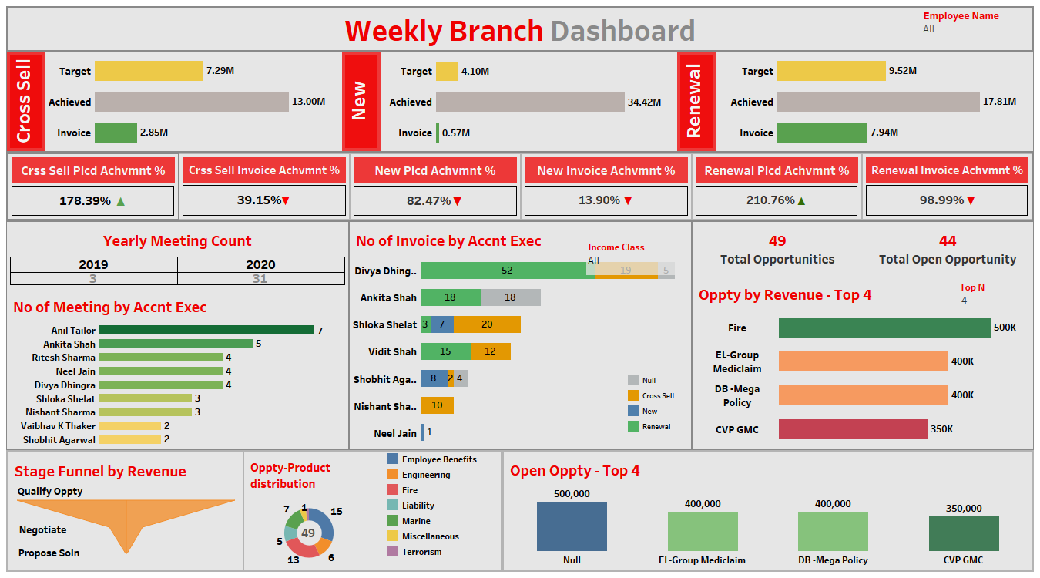
Report Analytics & Dashboard Analytics for Stake-Holders
Sample Insurance Dashboard

Slide 8
Date | Time | Task Description
11-05-2023 | 10 AM – 11 AM | Project Kick-off Meeting
18-05-2023 | 10 AM – 11 AM | Implementation of KPI’s using Excel
25-05-2023 | 10 AM – 11 AM | Implementation of KPI’s using Tableau-SQL
01-06-2023 | 10 AM – 11 AM | Implementation of KPI’s using Power BI-SQL
08-06-2023 | 10 AM – 11 AM | Final Presentation of the Project

